Slide 1

PANTONE®
COLOUR OF THE YEAR 2022

Slide 2
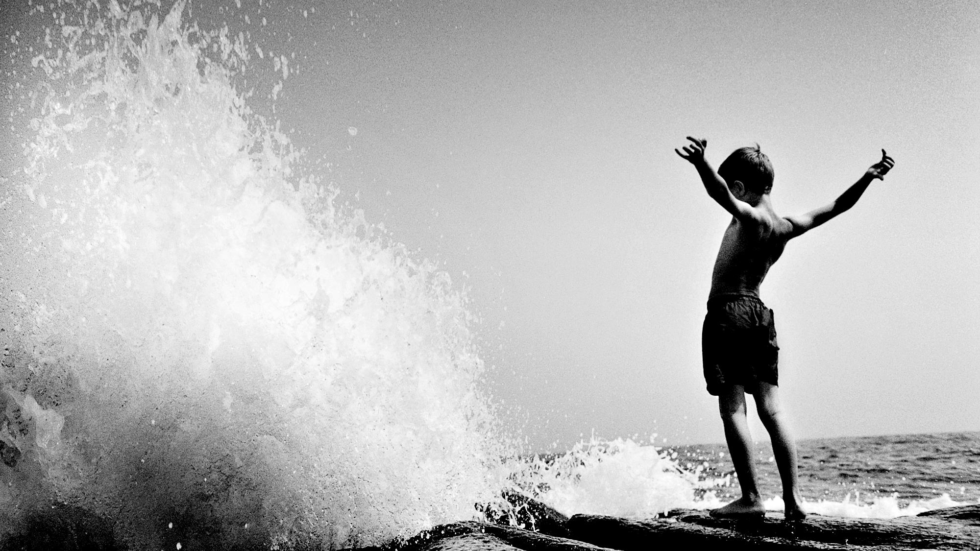
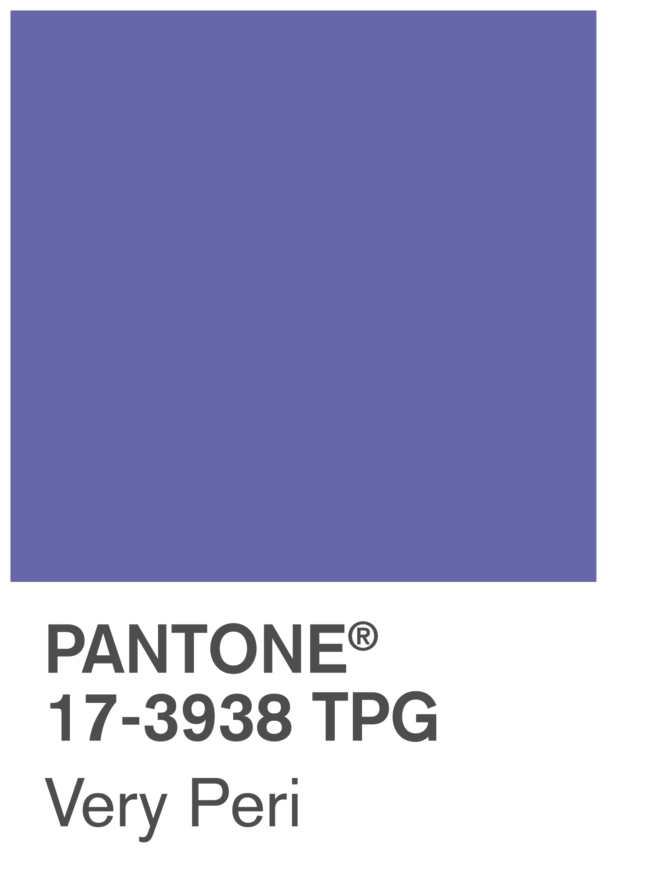
VERY PERI
Introducing the Pantone Colour of the Year 2022. PANTONE 17-3938 Very Peri is a dynamic hue that blends the faithfulness and constancy of blue with the energy and excitement of red.
The four colour palettes in this template feature Very Peri to help you express your ideas and convey the right mood. Read on to learn how to use these colours in any presentation.

Slide 3
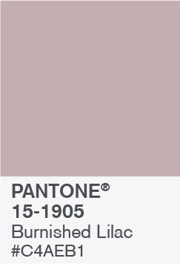
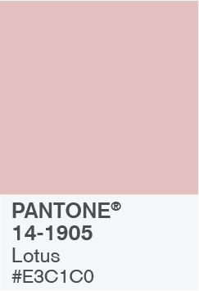
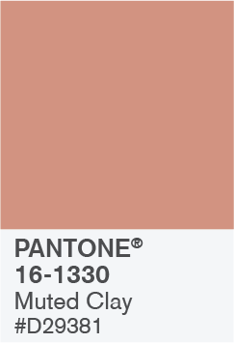
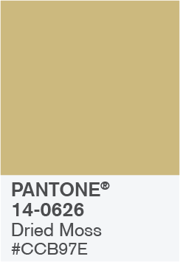
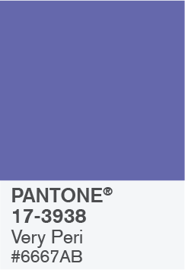
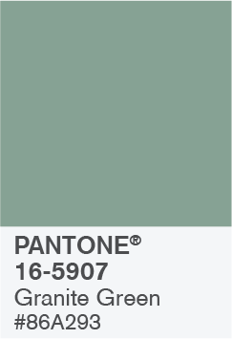
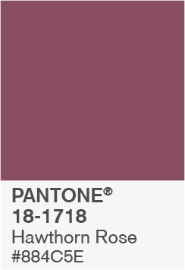
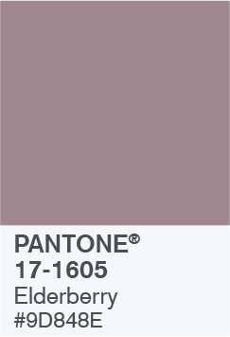
BALANCING ACT

Slide 4
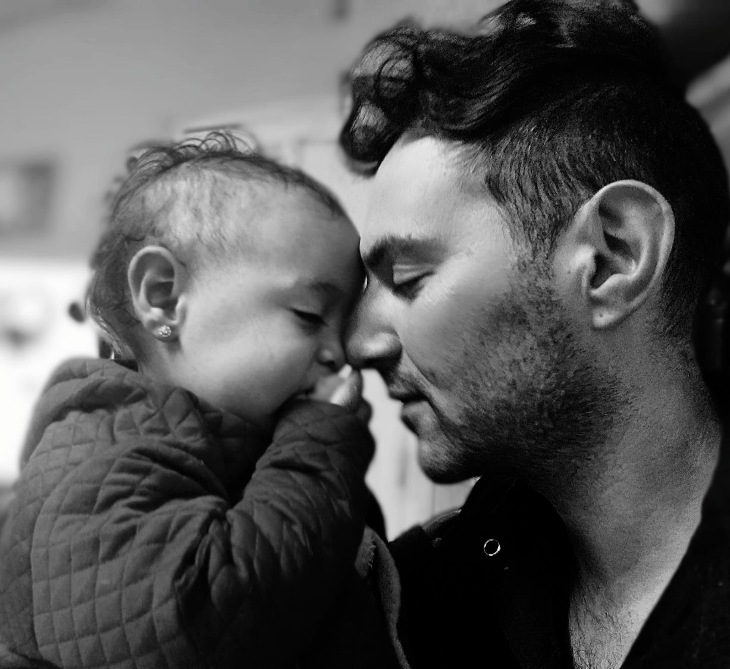
BALANCING ACT
Use this colour palette when you want a balance between warm and cool. PANTONE Very Peri is intensified within this artfully calibrated palette, injecting a feeling of liveliness and visual vibration.

Slide 5

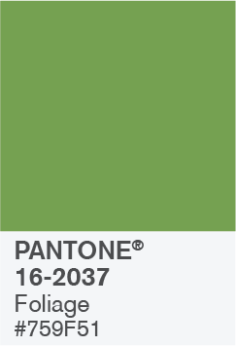
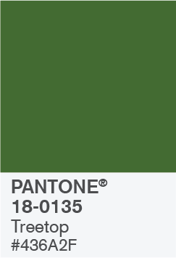
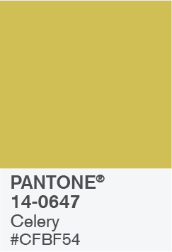
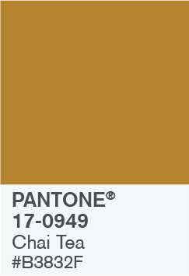
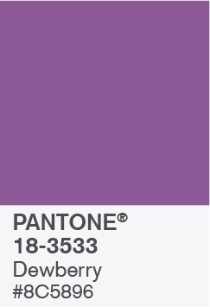
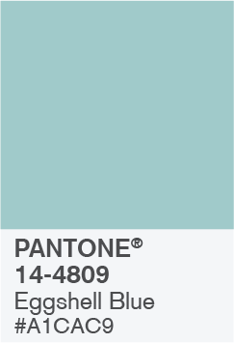
WELLSPRING

